Slide 1
Entropic Regularization for Adversarial Robust Learning
Jie Wang
Georgia Institute of Technology
April 25th, 2023
Joint work with Yifan Lin (Gatech), and
Song Wei (Gatech)

Slide 2
On the Robustness of ML Models

Slide 3
Adversarial Risk Minimization
Formulation:
Intractability:
Convex-Nonconcave Game
Nonconvex-Nonconcave Game
Connections with Optimal Transport:

Slide 4
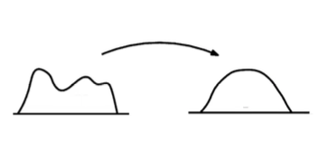
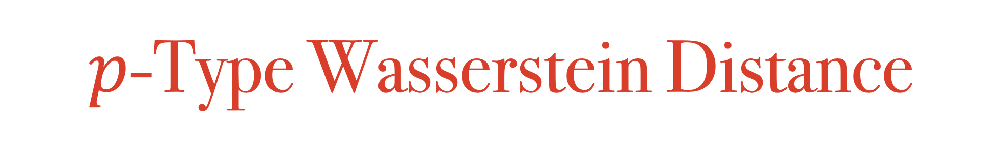
$p$-Type Wasserstein Distance
Geometric properties;
Flexibility: non-overlapping support, discrete and continuous.

Slide 5
Our Proposed Formulation
Original Formulation:
Formulation with Entropic Regularization:
Entropy:

Slide 6
Our Contribution (I)
Strong Dual Formulation:
Kernel Probability Distribution:

Slide 7
Our Contribution (II)
Recover Worst-case Distribution:

Slide 8
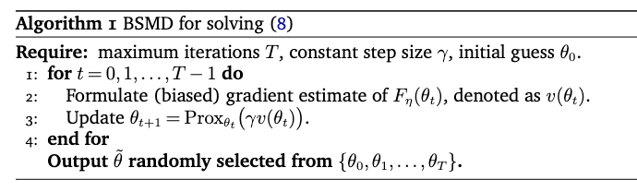
Our Contribution (III)
Tractable Algorithm for Dual Formulation:

Slide 9
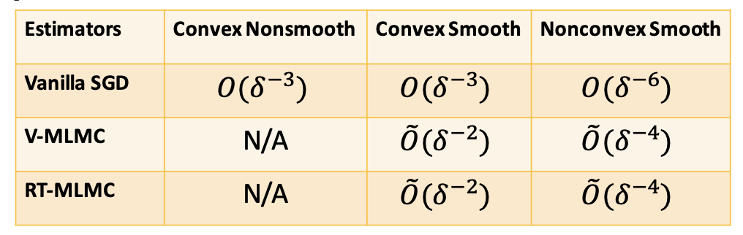
Our Contribution (III)
Tractable Algorithm for Dual Formulation:

Slide 10
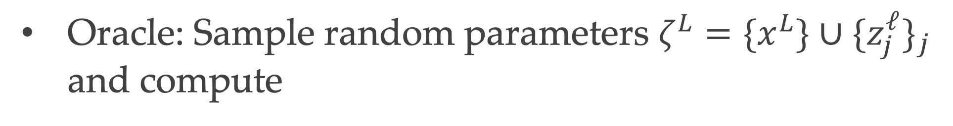
Vanilla SGD Estimator
Construct approximation function:
Oracle: Sample random parameters $ζ^{L}=\{x^{L}\}∪\{z_{j}^{ℓ}\}_{j}$ and compute
V-SGD: call oracle for several times and return avg

Slide 11

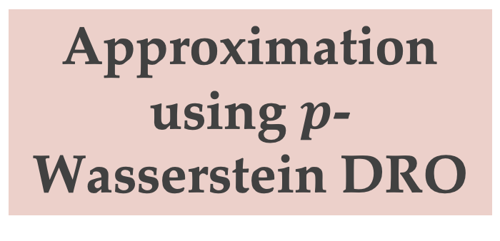
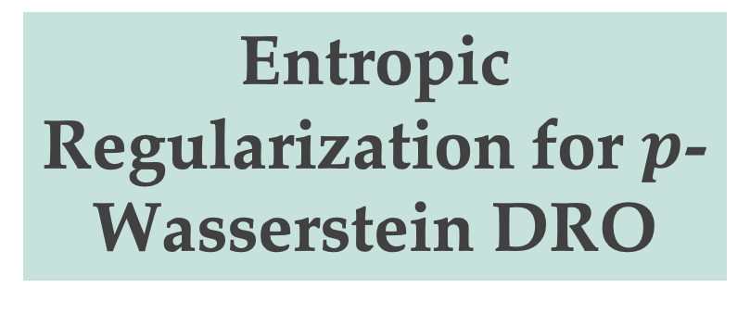
Connections with Existing Literature
Approximation using $p$-Wasserstein DRO
Sinha, et al. 2020
Origin of Adversarial Training
Aleksander, et al. 2017
Entropic Regularization for $p$-Wasserstein DRO
Adding Entropic Regularization Directly
Wang, et al. 2021

Slide 12
Numerical Study
Cifar-10 Dataset
Cifar-100 Dataset

